Slide 1
Application I: Efficient SAR Imaging for Non-Cooperative Scanning Geometries
Josiah Smith

Slide 2
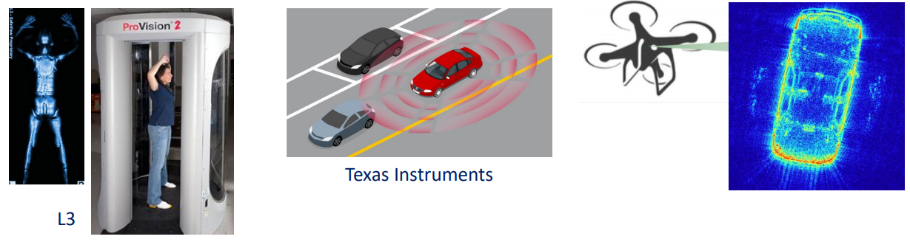
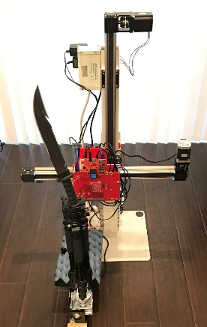
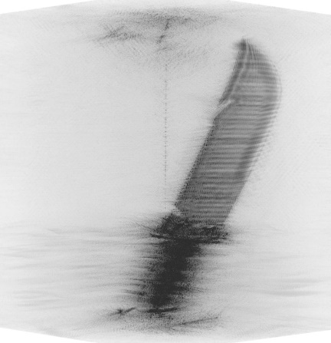
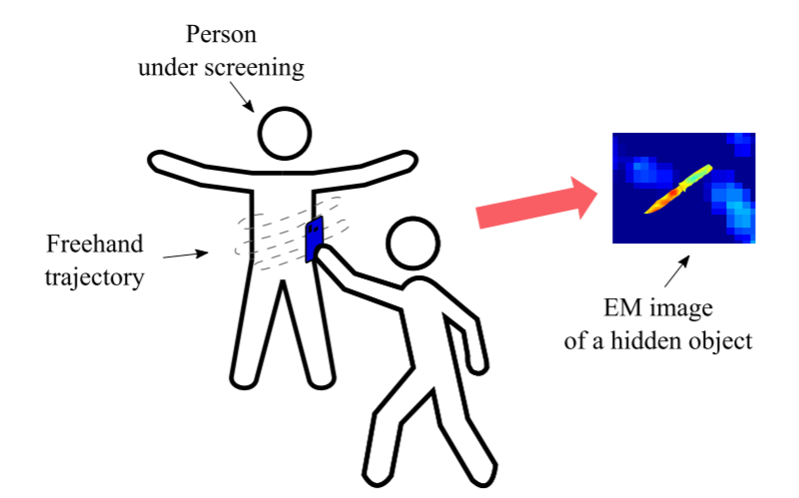



Motivation – Non-Cooperative Array Imaging
Traditional array imaging techniques require highly controlled positioning for SAR scanning apparatus
Emerging applications require relaxing this constraint
Smart phone mmWave scanner: mobile threat detection
ISSUE: limited computation power on cell phone
Automotive SAR imaging
Challenge:
Efficient image reconstruction algorithms rely on simple scanning patterns
Non-cooperative scanning patterns are typically considered infeasible due to computational expense
Traditional Array Imaging: Controlled Scanning Pattern

Slide 3
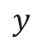
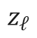
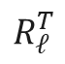
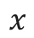
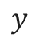
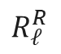
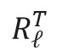
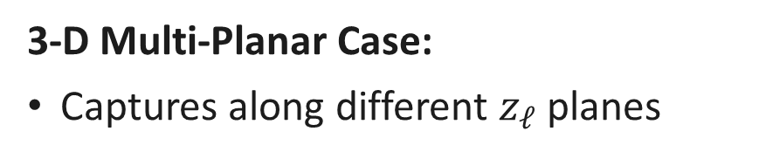

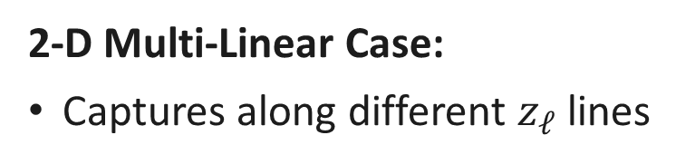
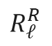
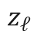

Multi-Planar Array Concept
2-D Multi-Linear Case:
Captures along different $z_{ℓ}$ lines
3-D Multi-Planar Case:
Captures along different $z_{ℓ}$ planes
$$y$$
$$y$$
Tx
Tx
Rx
Rx
$$x$$
$$R_{ℓ}^{R}$$
Target
$$R_{ℓ}^{R}$$
$$R_{ℓ}^{T}$$
$$R_{ℓ}^{T}$$
Target
$$z_{ℓ}$$
$$z$$
$$z$$
$$z_{ℓ}$$

Slide 4
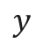
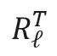
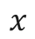
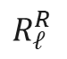
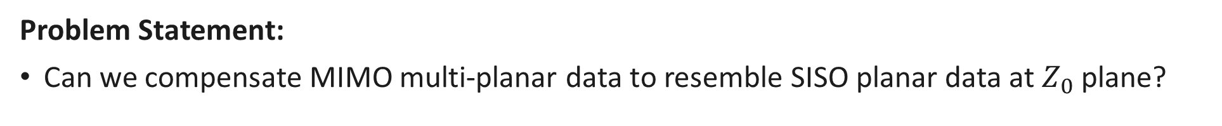
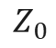

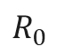
Multi-Planar Array Compensation
Problem Statement:
Can we compensate MIMO multi-planar data to resemble SISO planar data at $Z_{0}$ plane?
$$y$$
Tx
Rx
$$x$$
$$R_{ℓ}^{R}$$
$$R_{0}$$
$$R_{ℓ}^{T}$$
Target
$$Z_{0}$$
$$z$$

Slide 5
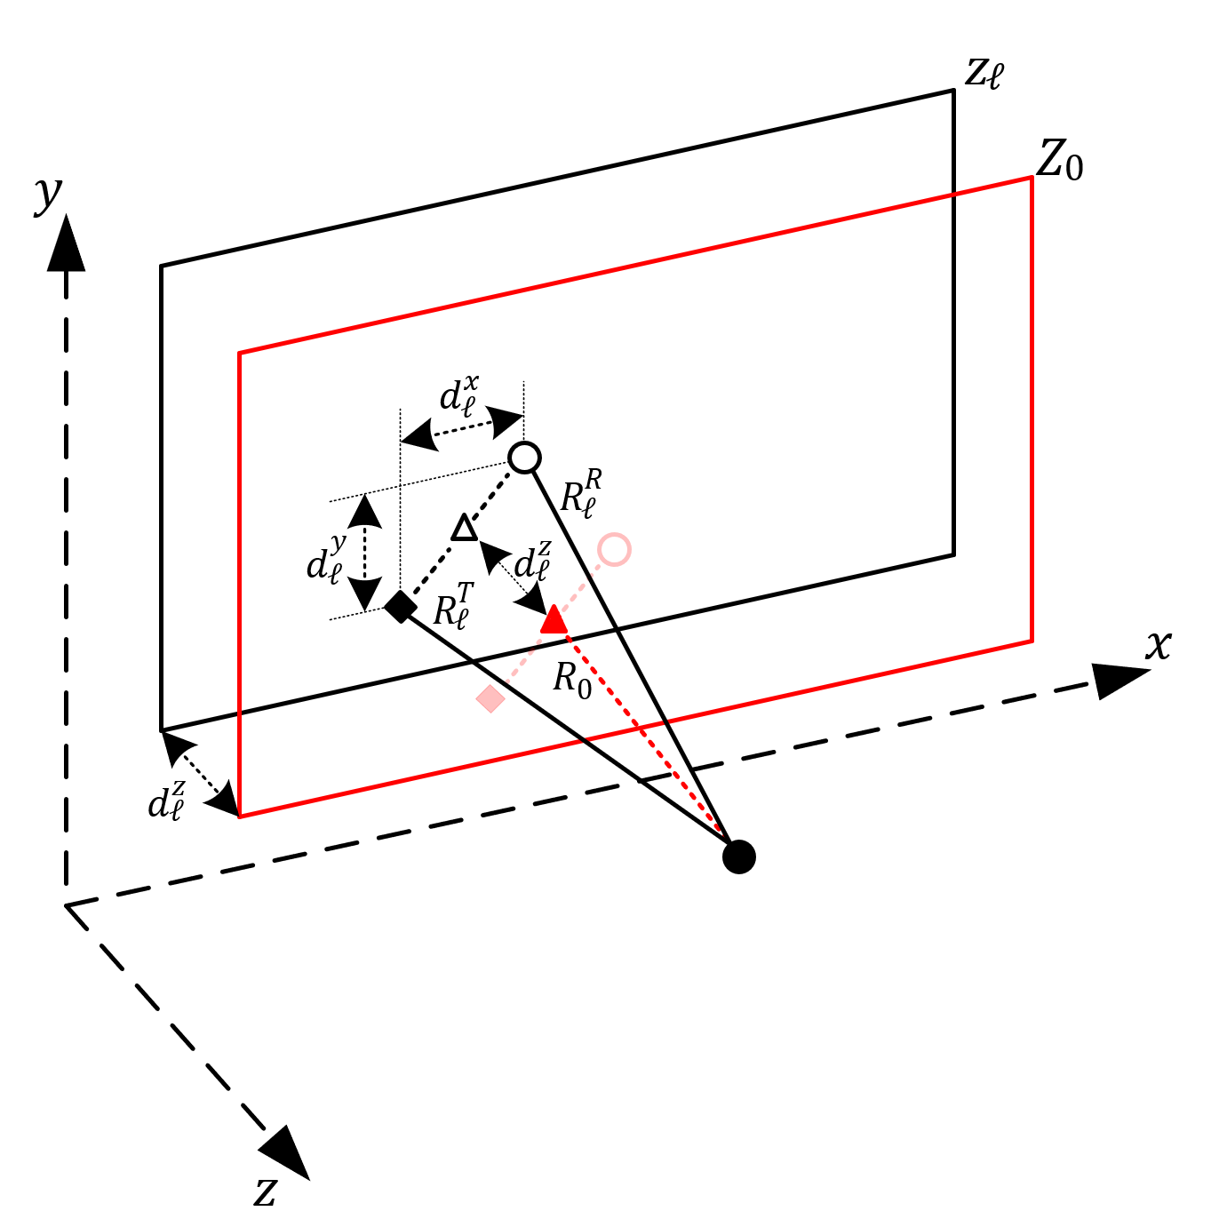
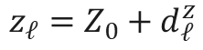
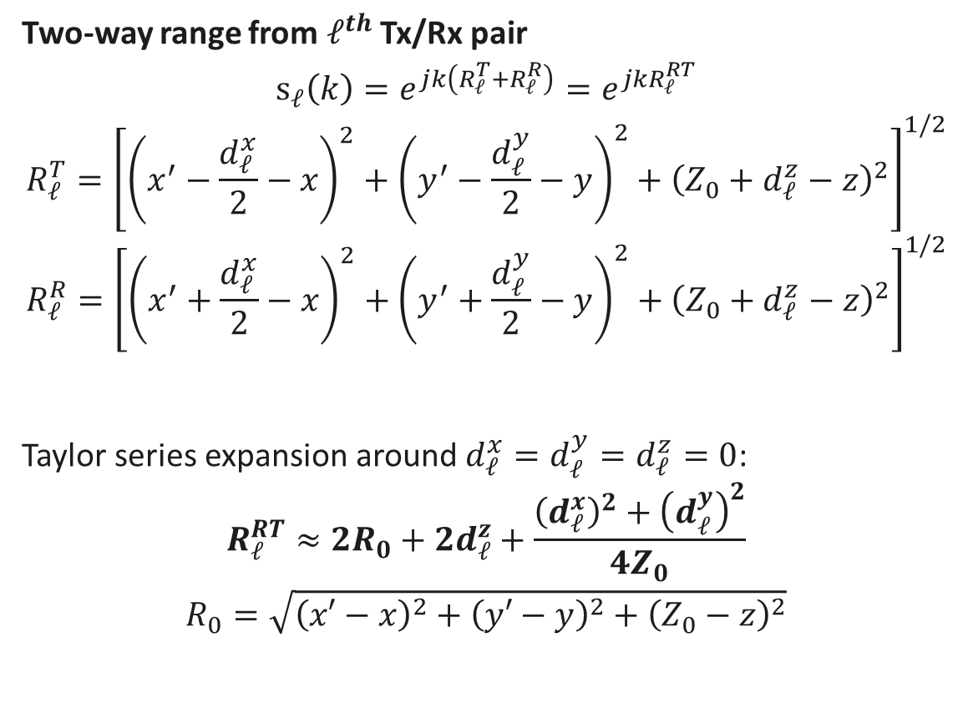
Signal Model
Two-way range from $ℓ^{th}$ Tx/Rx pair
$$s_{ℓ}\left(k\right)=e^{jk\left(R_{ℓ}^{T}+R_{ℓ}^{R}\right)}=e^{jkR_{ℓ}^{RT}}$$
$$R_{ℓ}^{T}={\left[{\left(x^{′}−\frac{d_{ℓ}^{x}}{2}−x\right)}^{2}+{\left(y^{′}−\frac{d_{ℓ}^{y}}{2}−y\right)}^{2}+{\left(Z_{0}+d_{ℓ}^{z}−z\right)}^{2}\right]}^{1/2}$$
$$R_{ℓ}^{R}={\left[{\left(x^{′}+\frac{d_{ℓ}^{x}}{2}−x\right)}^{2}+{\left(y^{′}+\frac{d_{ℓ}^{y}}{2}−y\right)}^{2}+{\left(Z_{0}+d_{ℓ}^{z}−z\right)}^{2}\right]}^{1/2}$$
Taylor series expansion around $d_{ℓ}^{x}=d_{ℓ}^{y}=d_{ℓ}^{z}=0$:
$$R_{ℓ}^{RT}≈2R_{0}+{2d}_{ℓ}^{z}+\frac{{\left(d_{ℓ}^{x}\right)}^{2}+{\left(d_{ℓ}^{y}\right)}^{2}}{4Z_{0}}$$
$$R_{0}=\sqrt{{\left(x′−x\right)}^{2}+{\left(y′−y\right)}^{2}+{\left(Z_{0}−z\right)}^{2}}$$
Tx
Rx
$$z_{ℓ}=Z_{0}+d_{ℓ}^{z}$$

Slide 6
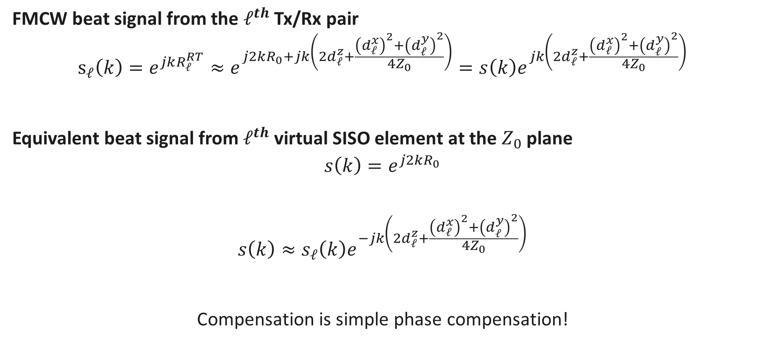
Signal Model (cont.)
FMCW beat signal from the $ℓ^{th}$ Tx/Rx pair
$$s_{ℓ}\left(k\right)=e^{jkR_{ℓ}^{RT}}≈e^{j2kR_{0}+jk\left(2d_{ℓ}^{z}+\frac{{\left(d_{ℓ}^{x}\right)}^{2}+{\left(d_{ℓ}^{y}\right)}^{2}}{4Z_{0}}\right)}=s\left(k\right)e^{jk\left(2d_{ℓ}^{z}+\frac{{\left(d_{ℓ}^{x}\right)}^{2}+{\left(d_{ℓ}^{y}\right)}^{2}}{4Z_{0}}\right)}$$
Equivalent beat signal from $ℓ^{th}$ virtual SISO element at the $Z_{0}$ plane
$$s\left(k\right)=e^{j2kR_{0}}$$
$$s\left(k\right)≈s_{ℓ}\left(k\right)e^{−jk\left(2d_{ℓ}^{z}+\frac{{\left(d_{ℓ}^{x}\right)}^{2}+{\left(d_{ℓ}^{y}\right)}^{2}}{4Z_{0}}\right)}$$
Compensation is simple phase compensation!

Slide 7
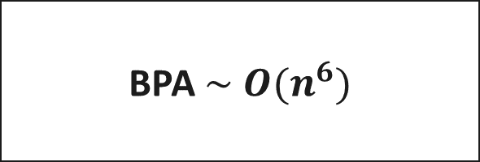

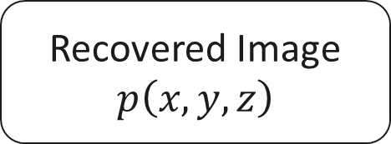

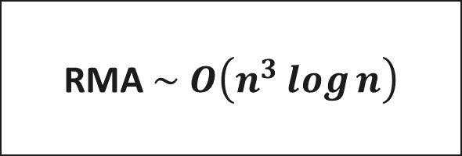
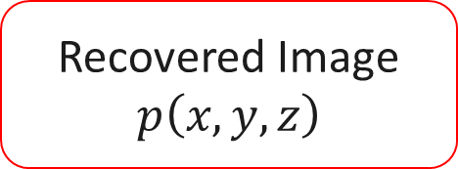

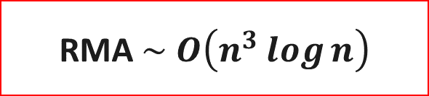

Algorithm Comparison
$$s_{ℓ}\left(k\right)$$
$$s_{ℓ}\left(k\right)$$
$$s_{ℓ}\left(k\right)$$
Phase Compensation
BPA $\sim O(n^{6})$
RMA $\sim O\left(n^{3}\log{n}\right)$
RMA $\sim O\left(n^{3}\log{n}\right)$
Recovered Image
$$p\left(x,y,z\right)$$
Recovered Image
$$p\left(x,y,z\right)$$
Recovered Image
$$p\left(x,y,z\right)$$

Slide 8
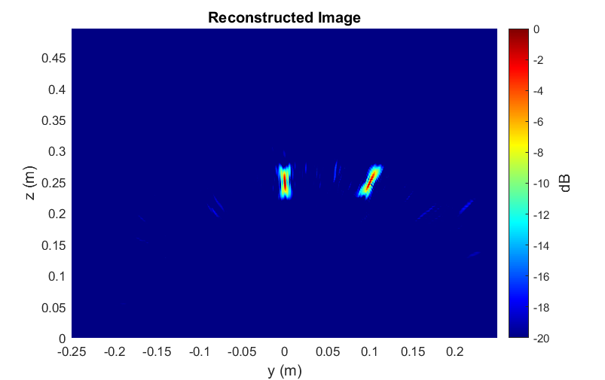
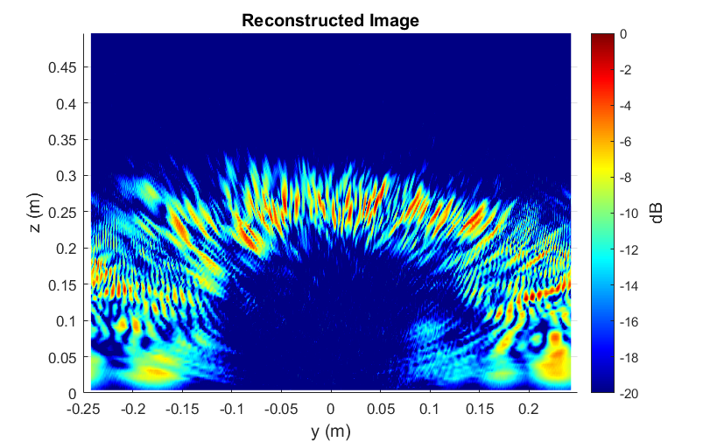
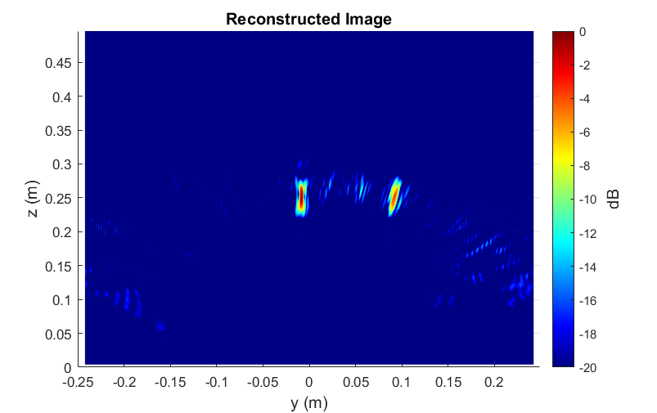
Simulation Results
Multi-Linear Array – Point Targets
Antenna perturbance: Gaussian
BPA – 5 mins
RMA – 30 ms
Ours – 30 ms

Slide 9
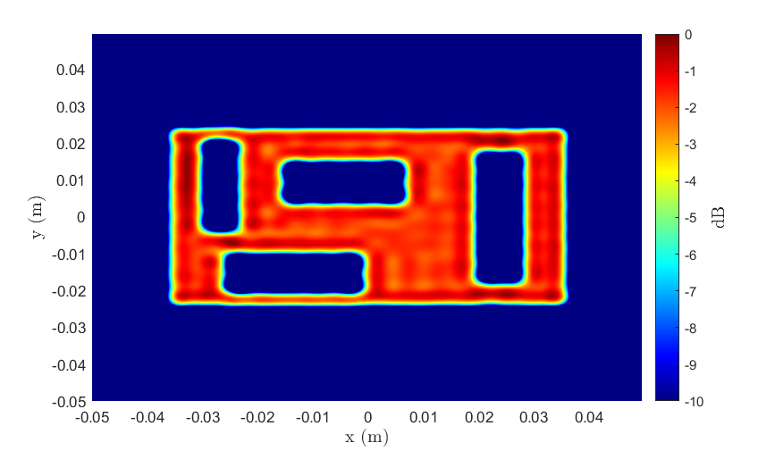
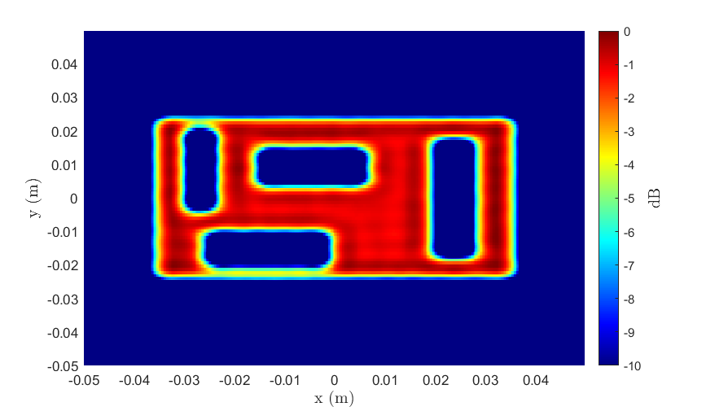
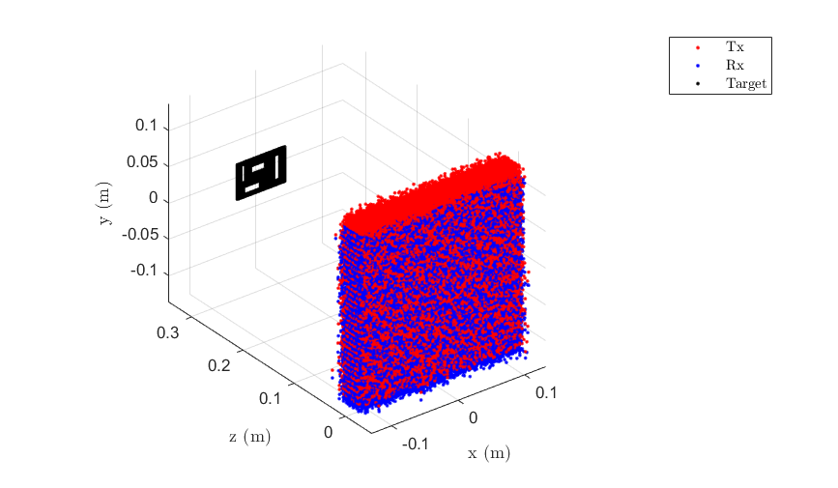
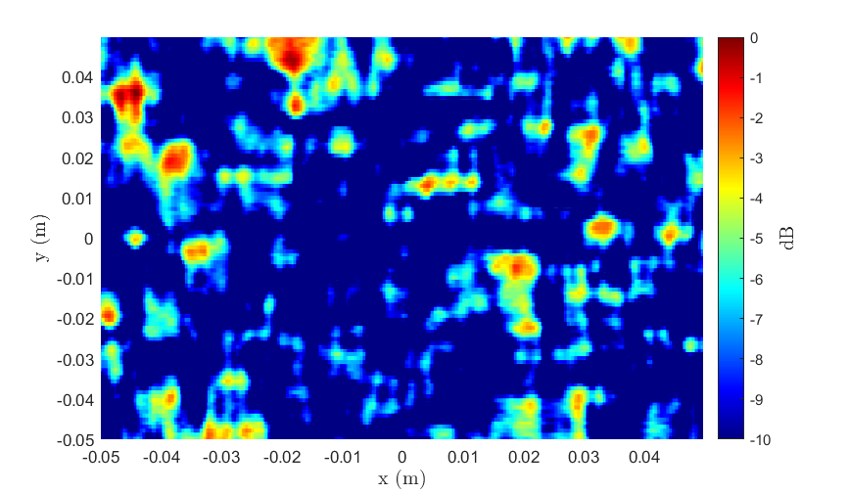
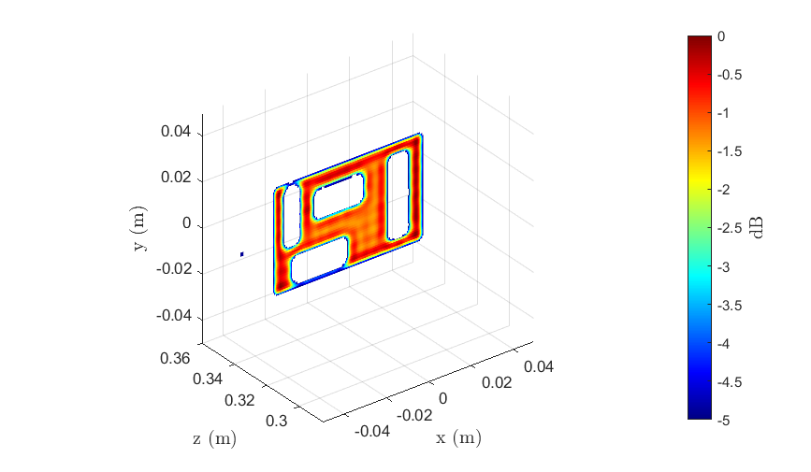
Simulation Results
Multi-Planar Array – Cutout
2-D BPA – 3 hrs
3-D BPA – 150 hrs
Ours – 1 s
RMA – 1 s
Ours – 14 s

Slide 10
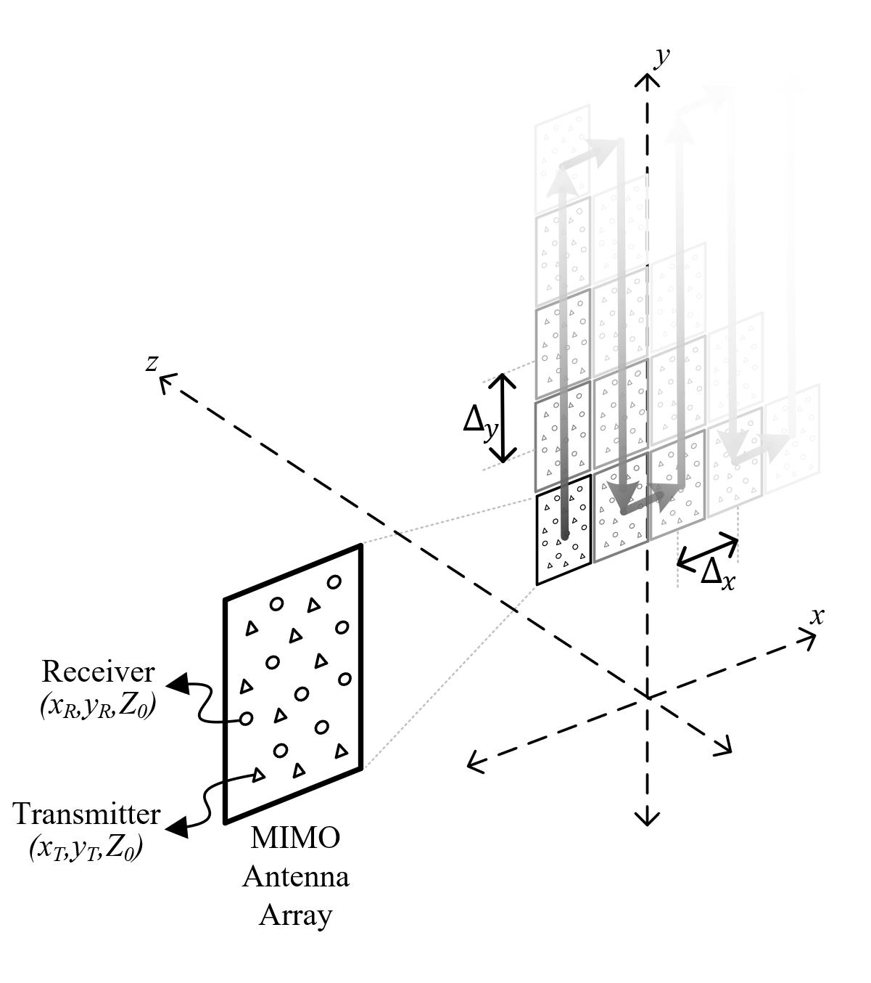

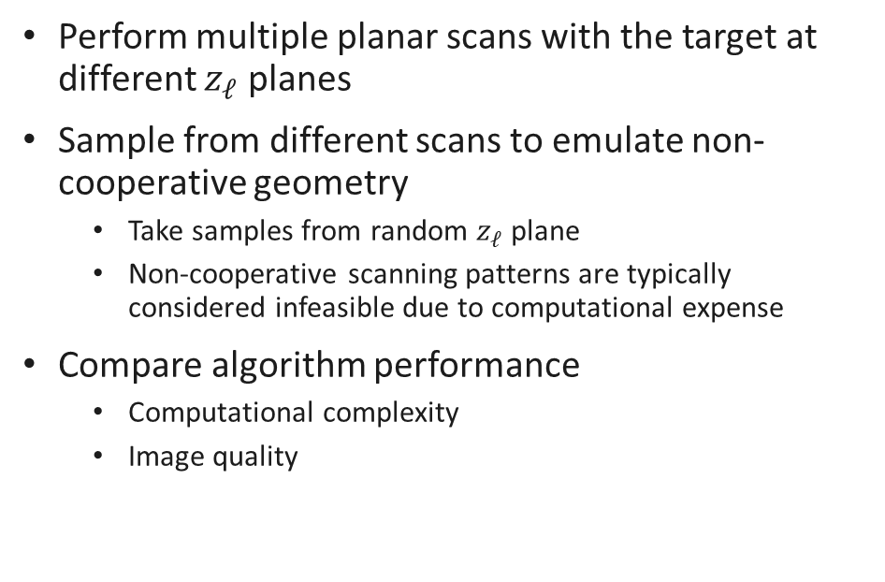
System Design
Multi-Planar Array – Emulate Non-cooperative Geometry
Perform multiple planar scans with the target at different $z_{ℓ}$ planes
Sample from different scans to emulate non-cooperative geometry
Take samples from random $z_{ℓ}$ plane
Non-cooperative scanning patterns are typically considered infeasible due to computational expense
Compare algorithm performance
Computational complexity
Image quality

Slide 11
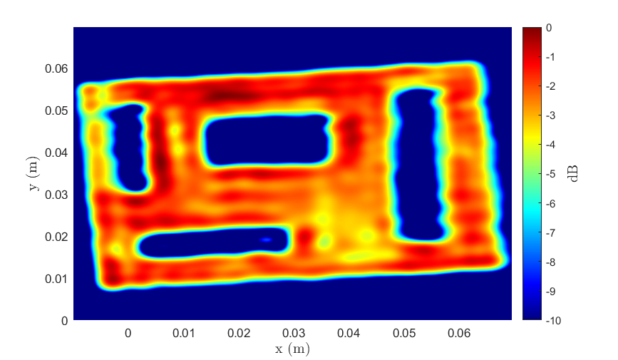
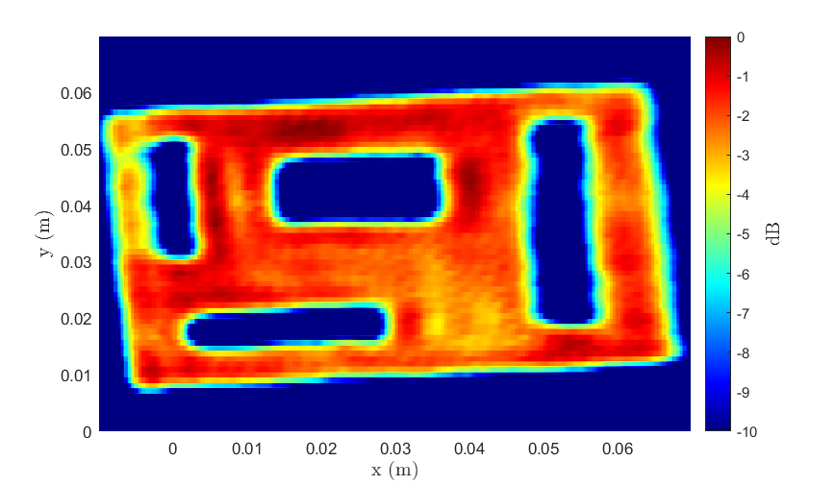
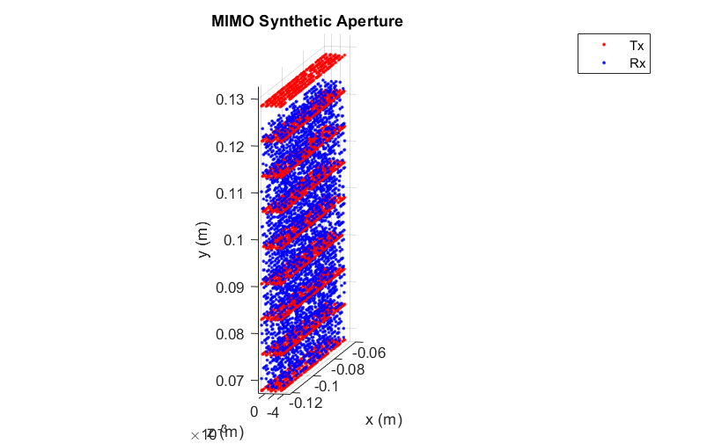
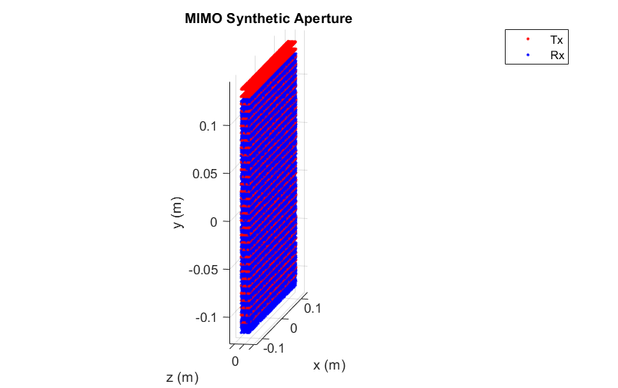
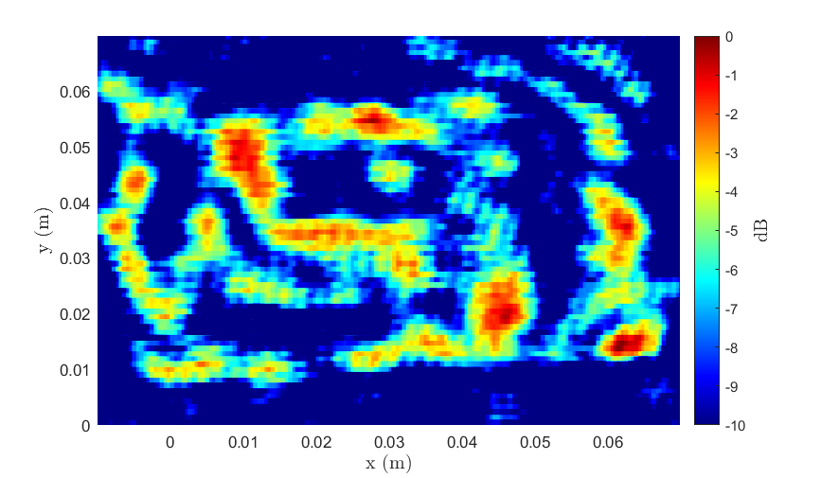
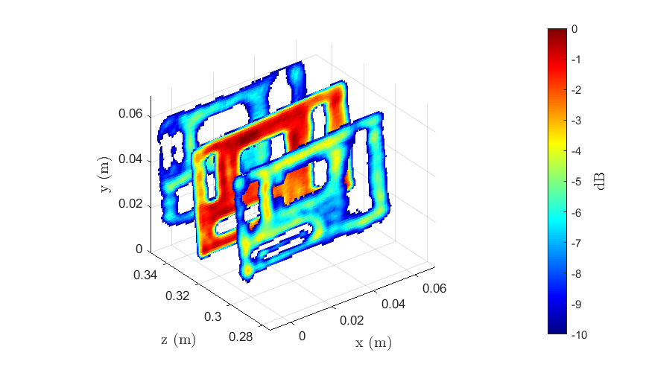
Real Results
Multi-Planar Array – Cutout
Antenna perturbance: Uniform Random
2-D BPA – 3 hrs
3-D BPA – 150 hrs
Ours – 1 s
RMA – 1 s
Ours – 14 s

Slide 12
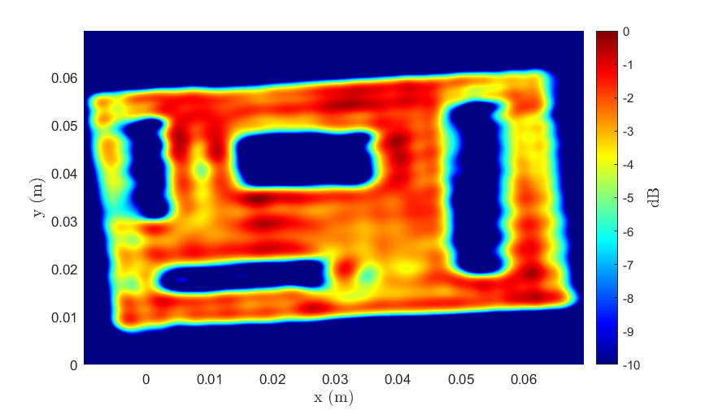
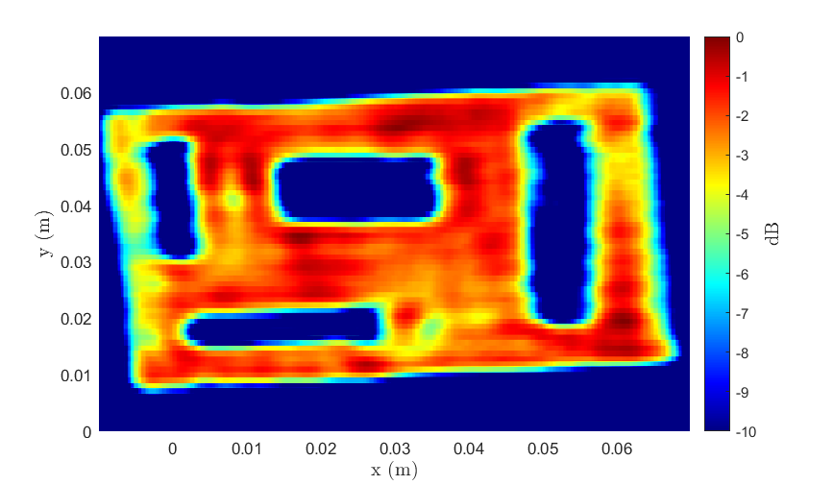
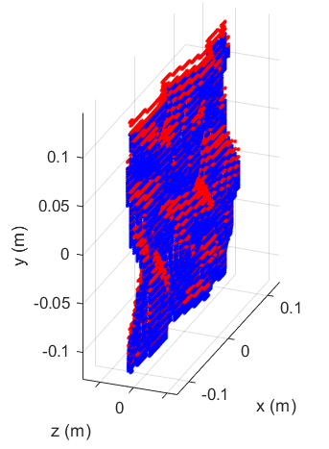


Real Results
Multi-Planar Array – Cutout
Antenna perturbance: Emulated Freehand
2-D BPA – 3 hrs
3-D BPA – 150 hrs
Ours – 1 s
RMA – 1 s
Ours – 14 s

Slide 13



Conclusions and Summary
Enables non-cooperative image computation on mobile devices, cell phones, IOT applications
Same computational complexity as RMA with comparable image quality to BPA
 | BPA | RMA | Ours
Computational Complexity | $$O\left(n^{6}\right)$$ | $$O\left(n^{3}\log{n}\right)$$ | $$O\left(n^{3}\log{n}\right)$$
Image Quality | Acceptable | Unacceptable | Acceptable
Sample Image

Slide 14
Application II Vital Sign Detection
Bhaskar Upadhyay

Slide 15
Agenda
Background
Problems
Proposed solutions
Results
Future direction

Slide 16








Motivation – Why non-contact vital signs detection?
Commercial vital sign (heart rate and respiration) detection systems traditionally wearable
Not feasible in all scenarios
Track vital signs of bed ridden patients to detect problems in breathing and sudden changes in heart rate
Even more important in case of burn victims and newborn babies
Applicable to numerous scenarios:
Track vital signs of drivers
Locating survivors in search and rescue missions

Slide 17




Vital Signs Detection Using FMCW Radars
FMCW Signal
Transmit a FMCW chirp signal$S_{Tx}\left(t\right)=\exp\left\{j \left\{2πf_{o}t+πμt^{2}+φ\left(t\right)\right\}\right\}$
Signal reflected from subject and a delayed version is received by the receiver
$$S_{Rx}\left(t\right)=B.S_{Tx}\left(t−τ\right)=B\exp\left\{j \left\{2πf_{o}(t−τ)+πμ{(t−τ)}^{2}+φ\left(t−τ\right)\right\}\right\}$$
The two are ‘mixed’, giving an IF signal, which contains information about the range and location of the subject
The phase changes caused by breathing and heart rates evaluated to extract vital signs
After ADC sampling, the IF signal at $i^{th}$ receive element is
Angle
$$y_{i}\left(m,p\right)= \sum_{n=1}^{K}{α_{n}exp\left\{j2π\left[\left(\frac{2μR_{n}}{c}\right)pT_{s}+\frac{2f_{o}R_{n}}{c}+\frac{\left(i−1\right)f_{o}dsin\left(θ_{n}\right)}{c}+\frac{{2r}_{b,n}f_{o}}{c}\sin\left(2πf_{b,n}\left(mT_{int}+pT_{s}\right)\right)+\frac{{2r}_{h,n}f_{o}}{c}\sin\left(2πf_{h,n}\left(mT_{int}+pT_{s}\right)\right) \right]\right\}}$$
Range
Breathing
Heartbeat

Slide 18

Problems
Sub mm scale vibrations
Low SNR of heart signal
Harmonics
Intermodulation products
Motion artifacts
Single channel systems and algorithms not robust
Harmonics
Respiration
Intermodulation Products
Weak Heart Signal
80
*
Heart Rate (bpm)
*
*
*
*
70
*
*
*
Spurs
*
*
*
*
60
Time (s)

Slide 19






Proposed Solution 1 – MIMO Rx Beamforming Based
Proposed Solution 2 – RF Lens Based
Lens
Radar
Radar

Slide 20









Proposed Solution 1 – MIMO Rx Beamforming Based
Proposed Solution 2 – RF Lens Based
People Counting
Search and Rescue
Driver fatigue
Sleep Monitoring

Slide 21

System Parameters
Parameter (FMCW) | Value
Number of Samples (fast time) | 128
Number of Frames (slow time) | 512
Frequency | 77 GHz
Bandwidth (BW) | 4 GHz
PRF (Slow Time) | 20 Hz
NRx antennas | 4
NTx antennas | 2
Measurement Time $\sim$ 25 s

Slide 22






Proposed Solution 1 – MIMO Rx Beamforming Based – Results
a. Vital Signs Spectrum
b. Vital Signs Pseudo Spectrum
Mean Absolute Error (MAE) – 1.69 bpm
Accuracy – 91.85 %
c. Heart Rate Tracking Across Time
e. Bland-Altmann Plot

Slide 23









RF Lens Based Solution – Lens Cage Experiments
1
2
SNR improvements due to the lens
Focusing property and lens geometry helps resolve echoes from different points on the body
Channel selection based on spectral PAPR
“Need based” Harmonic correction implemented
Don’t select this channel!
$$d_{fb}$$
DCA1000EVM
AWR1843BOOST
3
4
Lens placed at a distance $d_{fb}$ in front of sensor (back focal length of the lens)
3D printed lens cage designed for stability and movement
Subjects positional analysis done to identify capability of heart rate detection
Select this channel!
3D Printed Lens Cage System
LAT-115 Lens

Slide 24









Heart Rate Visibility Different Orientations of subject
Heart rate visible for all positions
Peak strength varies
Lens based approach can be applied for applications with positional changes
Sleep monitoring
Heart rate peak

Slide 25




Heart Rate Tracking Still subject facing sensor
Heart Rate Tracking Across Time
Limited experiments, promising results
Subject still
Accuracy $≈$ 90 % (at optimal points)

Slide 26


Summary of Pilot Studies
Combining Technique | Max Peak Isolated
Non Coherent | $$\sim 20\%^{∗}$$
Rx – Beamforming + PAPR Condition on angle bin | $$\sim 60\%$$
Current Problems
Motion corruption increases progressively from laying down to sitting to standing positions.
Artifacts of small scale body motion appear at vital sign frequencies.
Current Research
Time frequency analysis to resolve and remove effect of motion.
Utilize algorithm for real time application with motion.
Goal
Make algorithm robust even against motion.
Combining Technique | Max Peak Isolated
Rx Beamforming Peak Tracking and Counting | $$\sim 91\%$$
Mean Absolute Errors | 1.69 bpm
Use of lens improves vital signs detection
Doppler Peak to Average Power Ratio (PAPR) method utilized for channel selection.
With harmonic check algorithm added, accuracy increases further. (> 90%)
Both solutions are worth exploring – use depends on application case

